Slide 1
Module 1: Lesson 2 Big Data Overview

Slide 2
What is Big Data?
Big data refers to data possessing a range of confounding properties including (but not only) massive volume
These properties renders big data difficult to handle by the tools and services used to create traditional data science pipelines
It is also data which cannot be comprehended or have its full value realized when sampled or used in smaller amounts
[Source: https://ana.blogs.com/maestros/2006/11/data_is_the_new.html]

Slide 3
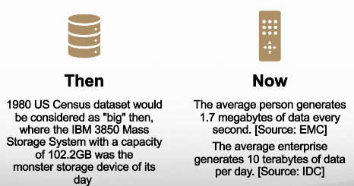
What is Big Data?
The concept of Big Data is relative to the storage and processing capability (or cost) of prevalent technology of the time

Slide 4
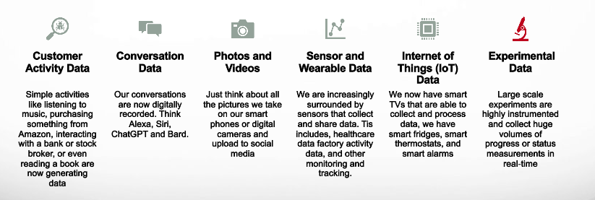
Where Does Big Data Come From?

Slide 5
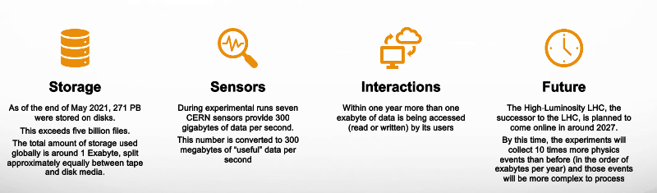
Big Data in the Real World
CERN’s Large Hadron Collider (LHC), the world’s most powerful particle accelerator, generates a massive amount of data. Each year scientists are faced with about 30 petabytes of data to analyze for a wide range of physics experiments, including studies on the Higgs boson and dark matter

Slide 6
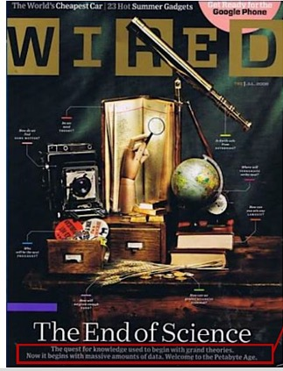
Does Big Data Have the Answers?
Big data is revolutionizing scientific research, enabling scientists to analyze massive datasets to develop new insights, develop new treatments, and make advancements in various fields.
On June 23, 2008, Chris Anderson, , Editor-in-chief of Wired magazine posted an article on Wired's website, “The end of theory: the data deluge makes the scientific method obsolete”
Anderson’s observation was that the quest for knowledge has shifted from beginning with hypotheses to starting with massive amounts of data
Traditionally, the scientific method often began with a hypothesis, followed by data collection and experimentation. In contrast, the availability of vast datasets allows researchers to discover patterns from the data itself
In other words, we no longer need to speculate and hypothesize; we simply need to let machines lead us to the patterns, trends, and relationships in social, economic, political, and environmental relationships

Slide 7
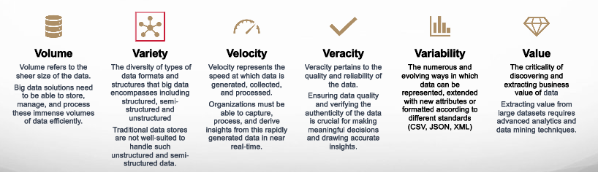
What are Big Data’s Confounding Properties?
The Six V’s of Big Data: The characteristics used to describe and understand the key aspects of massive and complex datasets that fall under the umbrella of big data

Slide 8
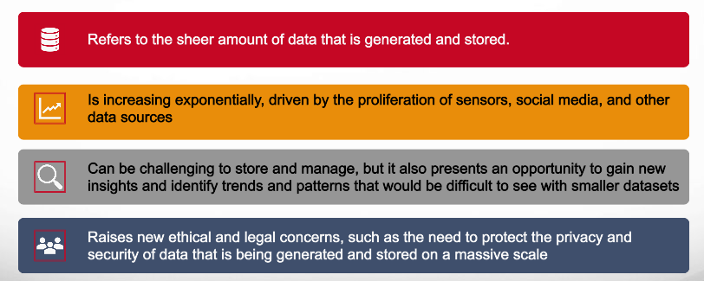
What is Big Data Volume?
1,000 gigabytes in a terabyte, 1,000 terabytes in a petabyte​ 1,000 petabytes in an exabyte, 1,000 exabytes in a zettabyte​

Slide 9
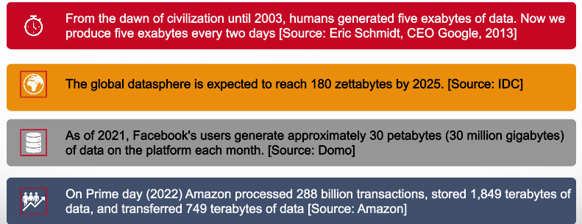
What is Big Data Volume?
1,000 gigabytes in a terabyte, 1,000 terabytes in a petabyte​ 1,000 petabytes in an exabyte, 1,000 exabytes in a zettabyte​

Slide 10
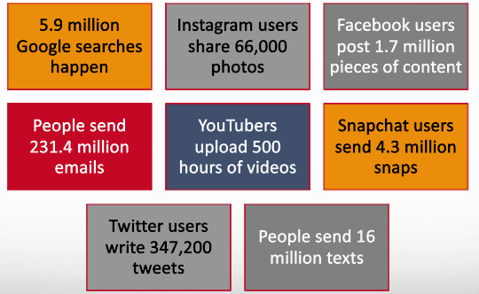
Big Data: How Big? Every 60 Seconds of the Day

